Slide 1
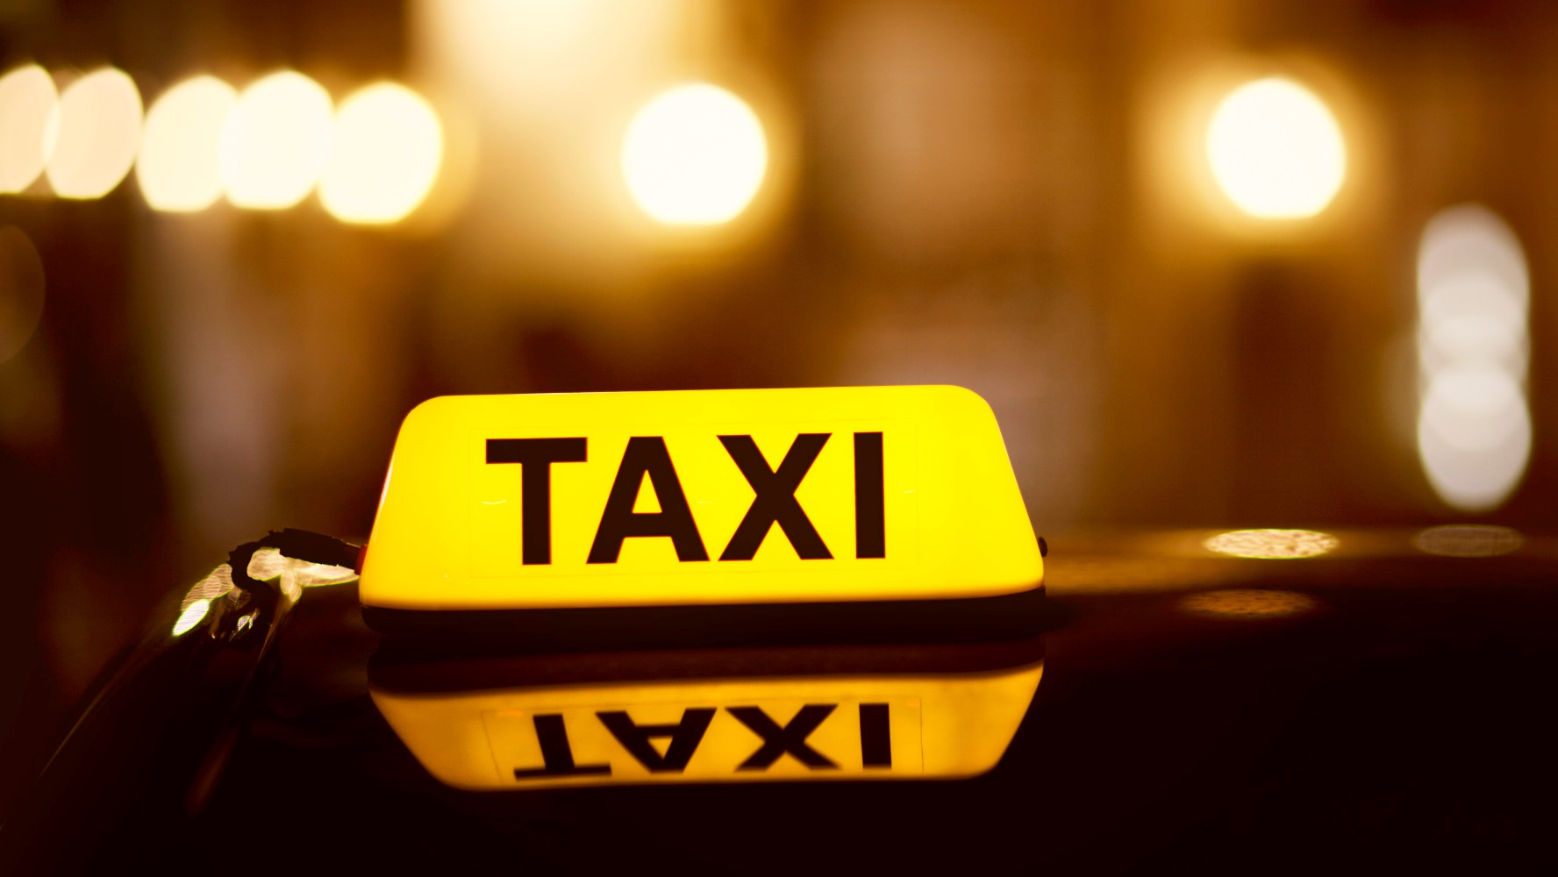
MIB
Final Presentation
Qifan Shi

Slide 2
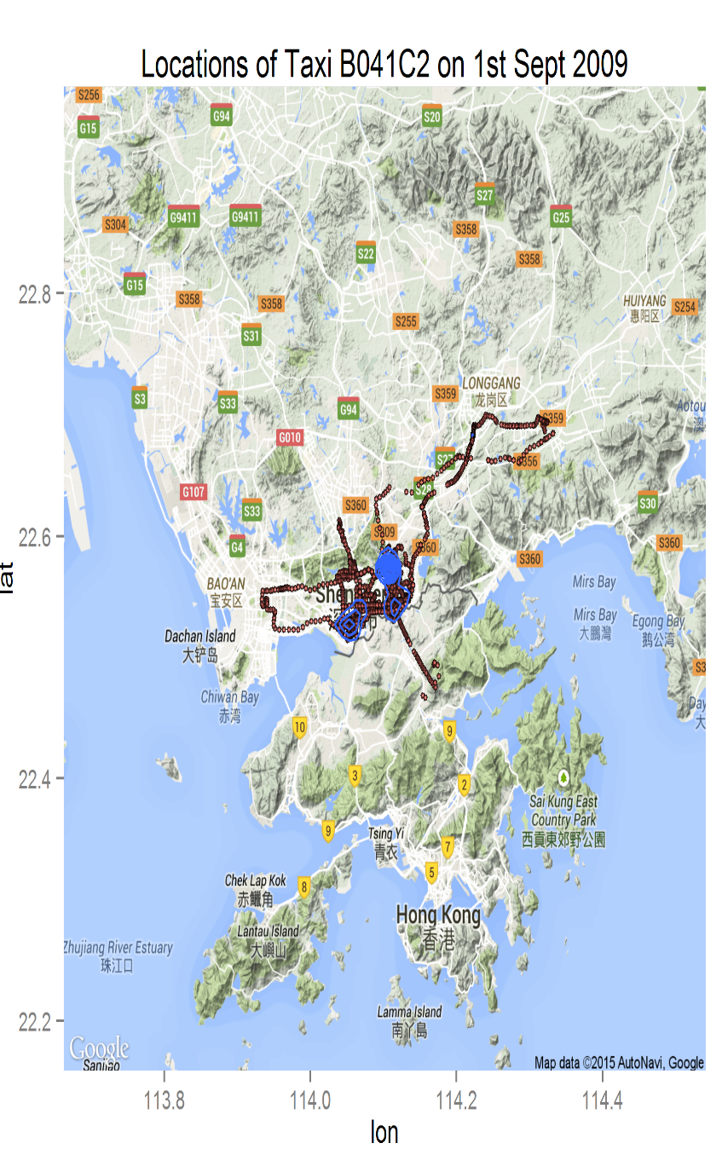
Here We Go!

Slide 3
Visualization
Questions
What is the entire taxi flow ?
How the flow varies hour by hour?
Business Value
Understand people’s behaviors
Catch up potential fare

Slide 4
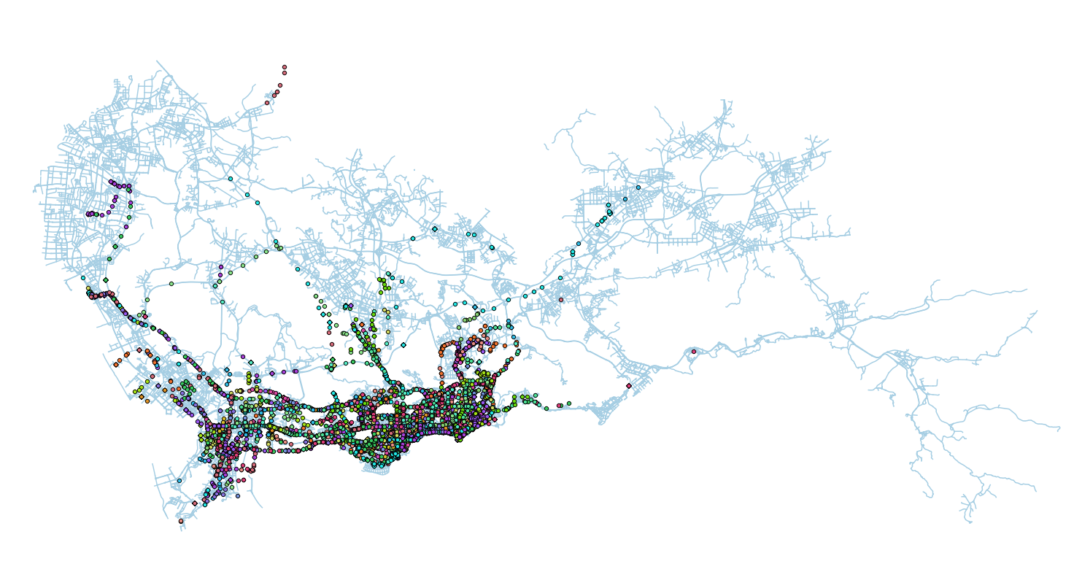
Entire Day of 09/08/2009

Slide 5
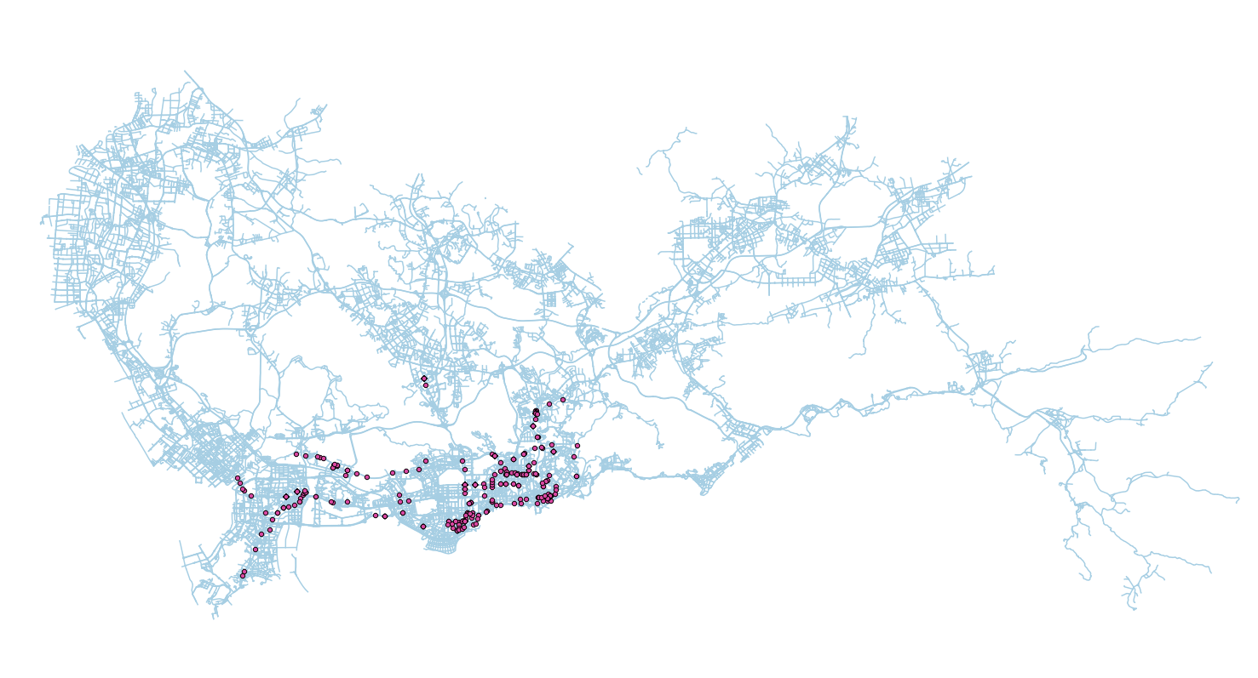
0 – 1 AM

Slide 6
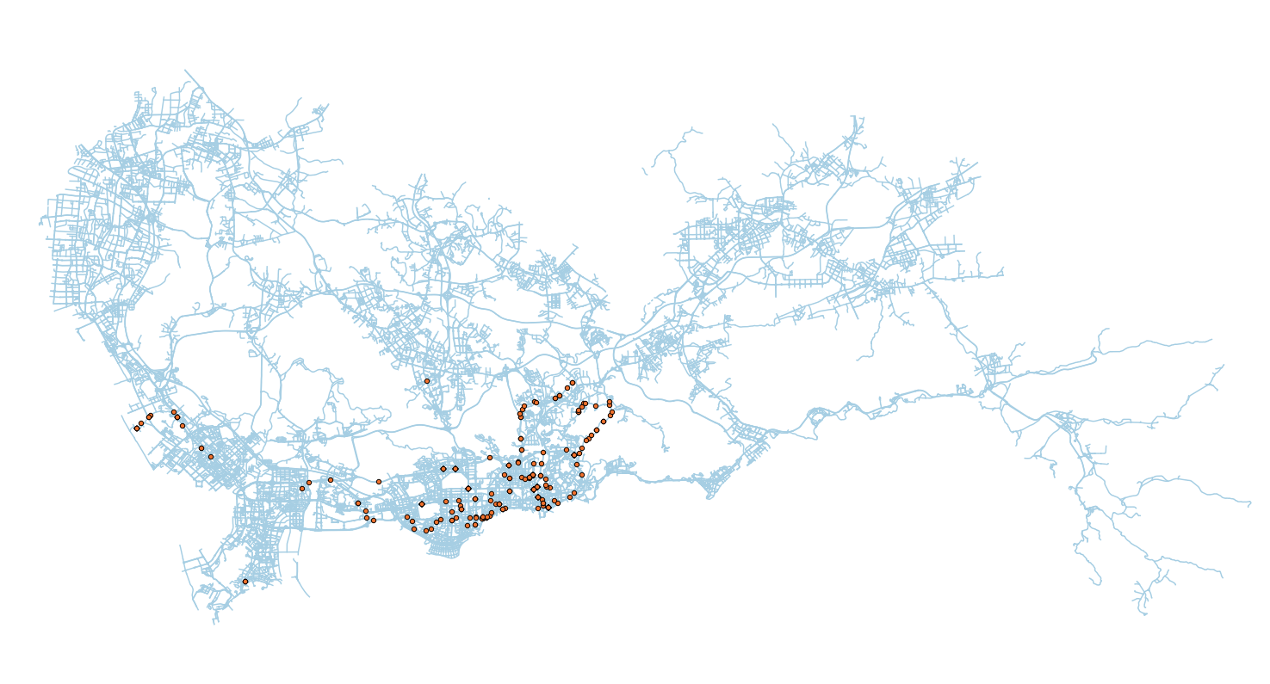
1 – 2 AM

Slide 7
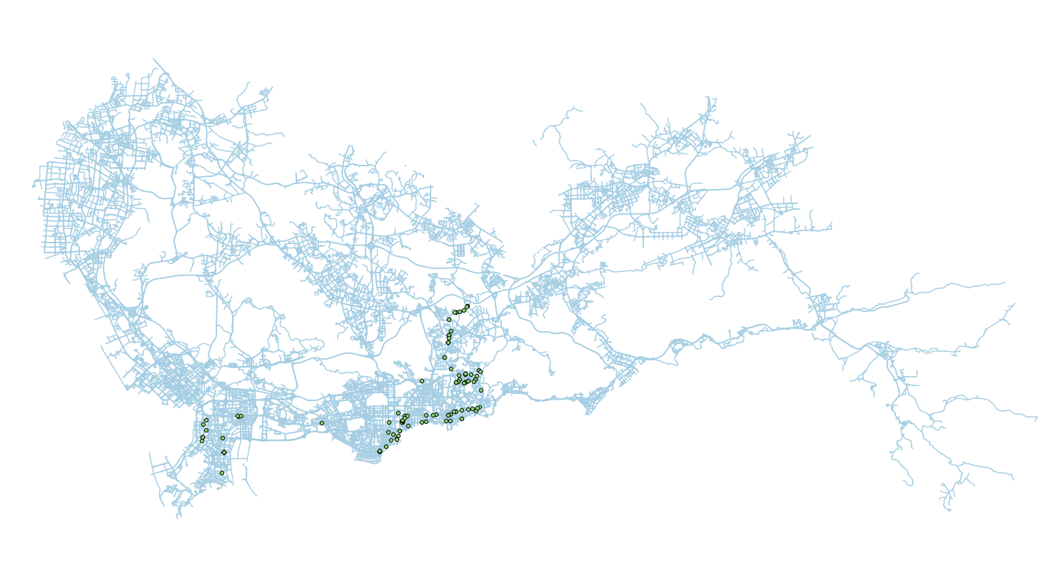
2 – 3 AM

Slide 8
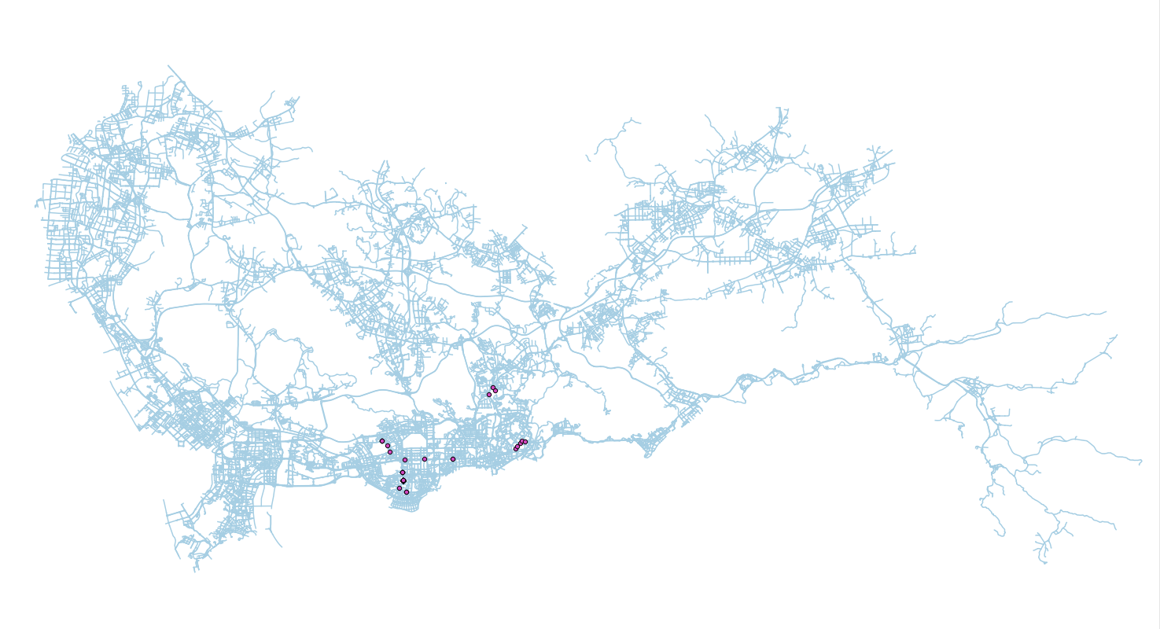
3 – 4 AM

Slide 9
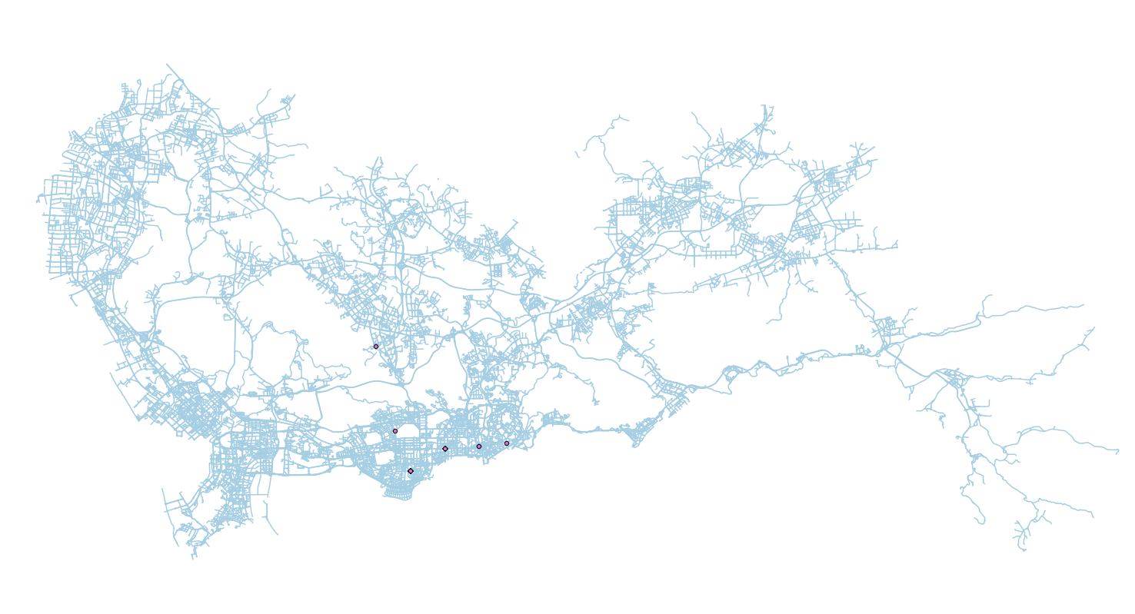
4 – 5 AM

Slide 10

5 – 6 AM

Slide 11

6 – 7 AM

Slide 12
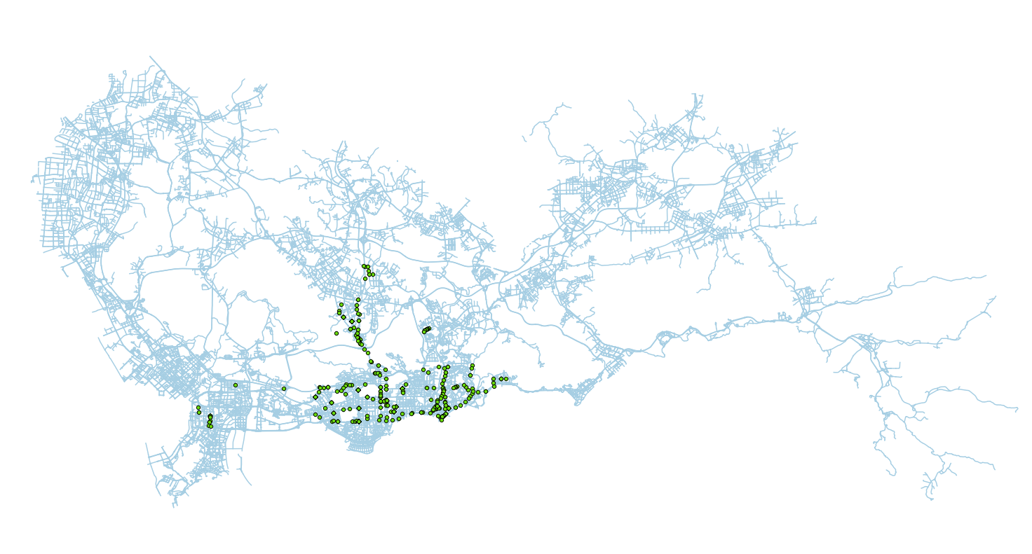
7 – 8 AM

Slide 13
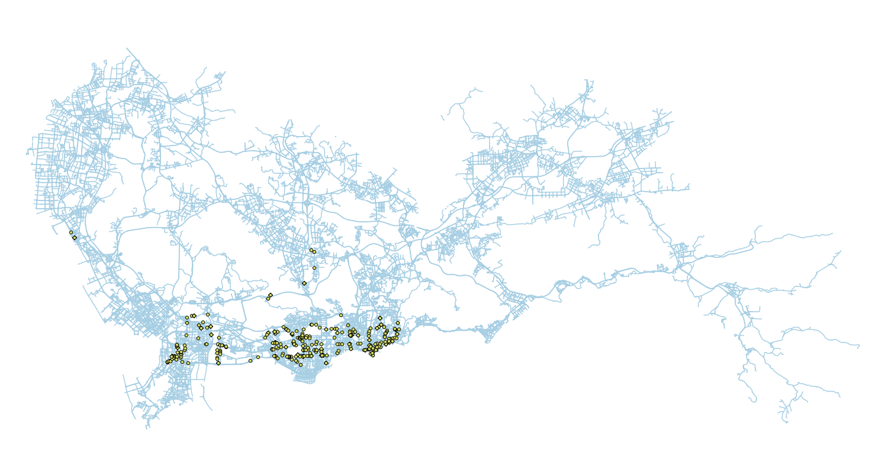
8 – 9 AM

Slide 14
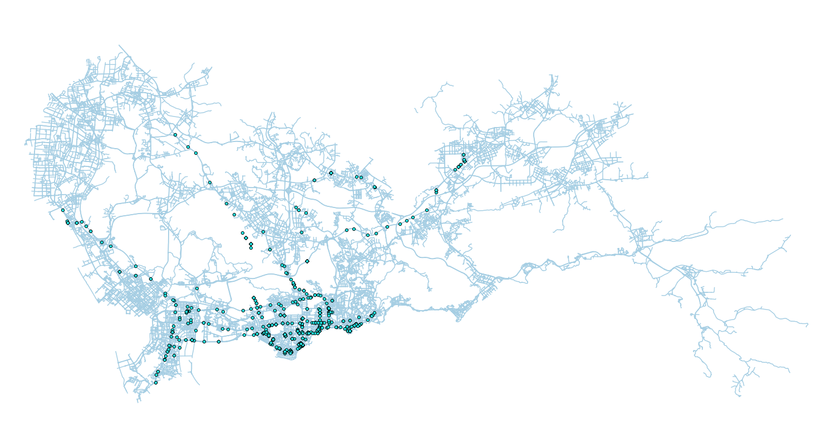
9 – 10 AM

Slide 15
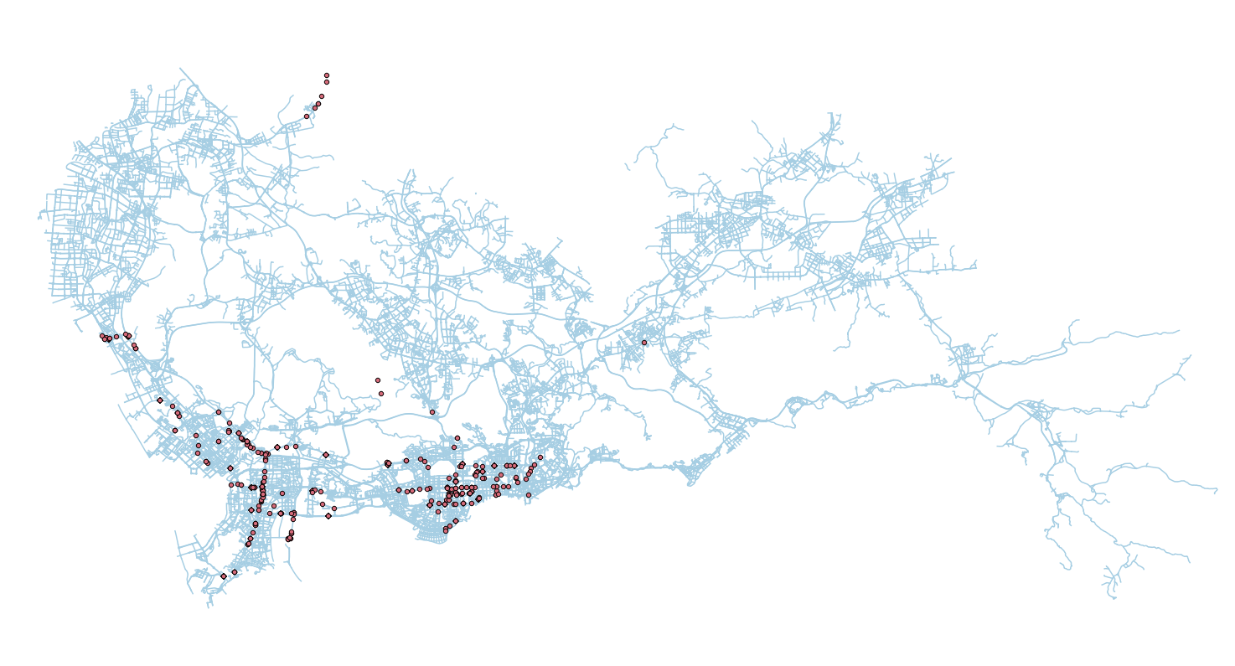
10 – 11 AM

Slide 16
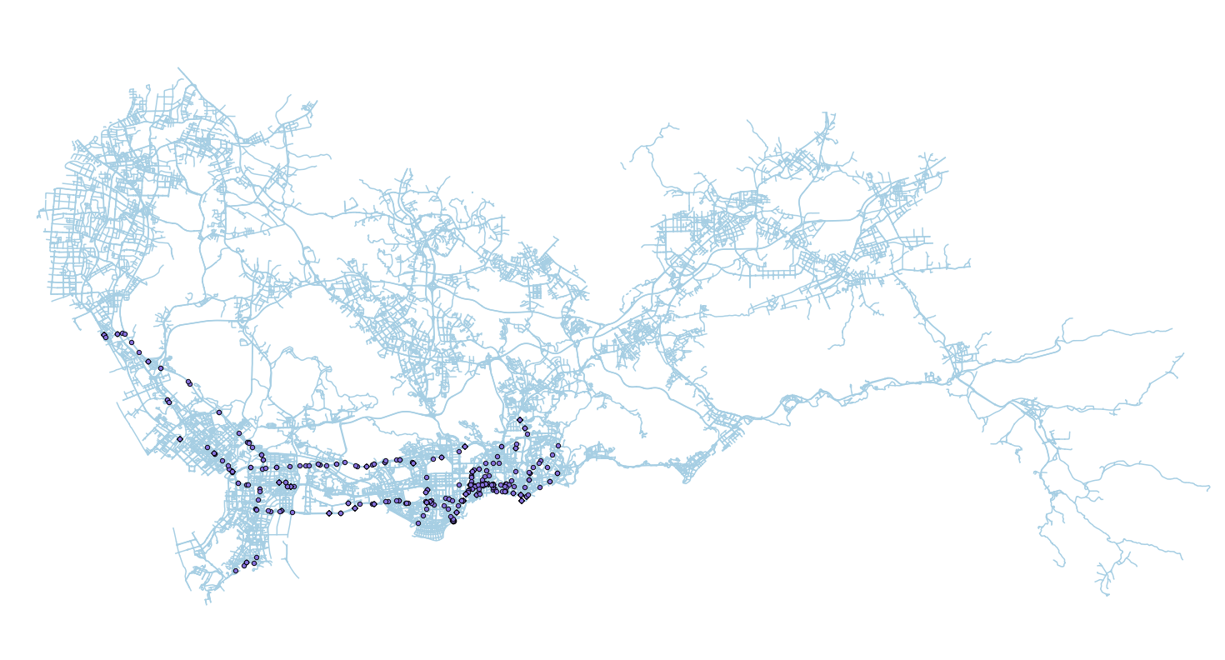
11 – 12 PM

Slide 17
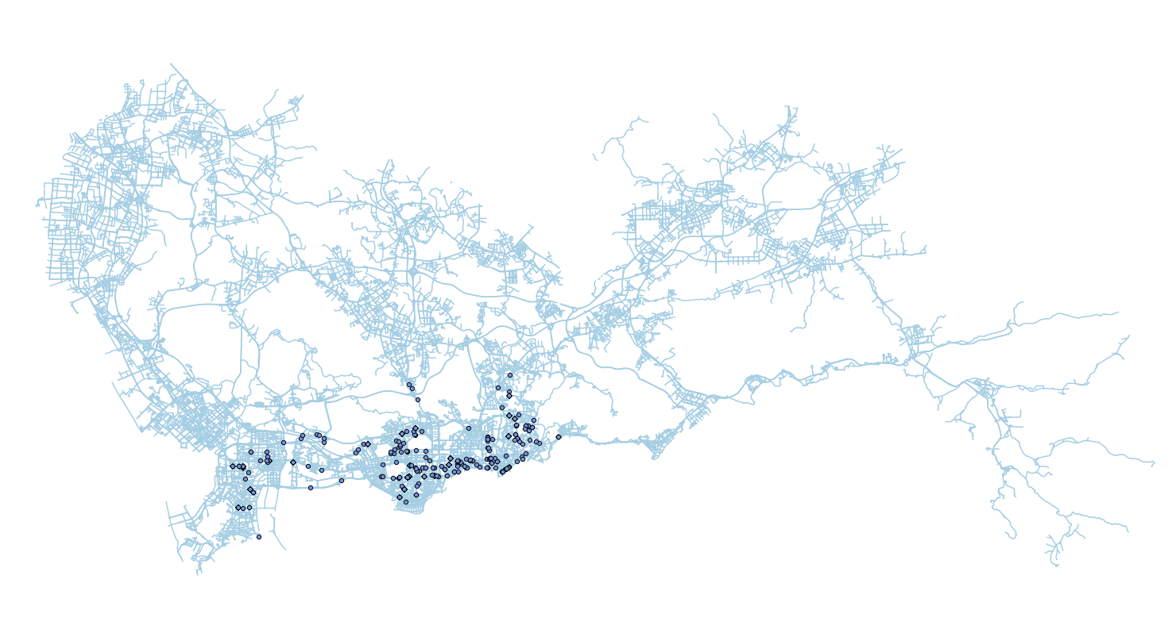
12 – 13 PM

Slide 18
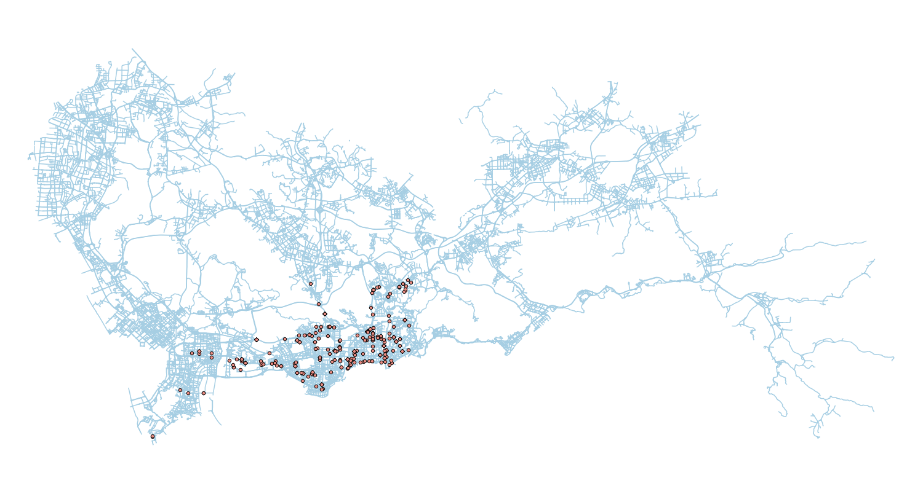
13 – 14 PM

Slide 19
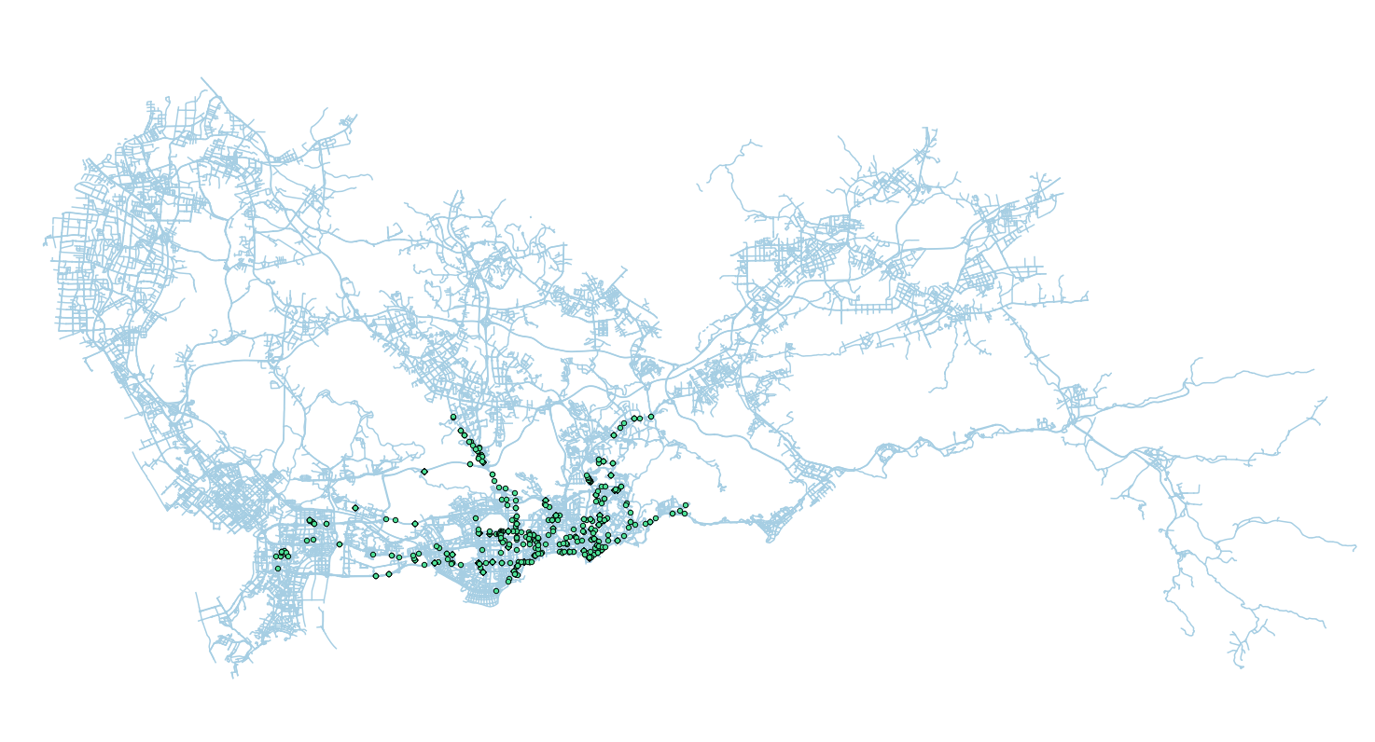
14 – 15 PM

Slide 20
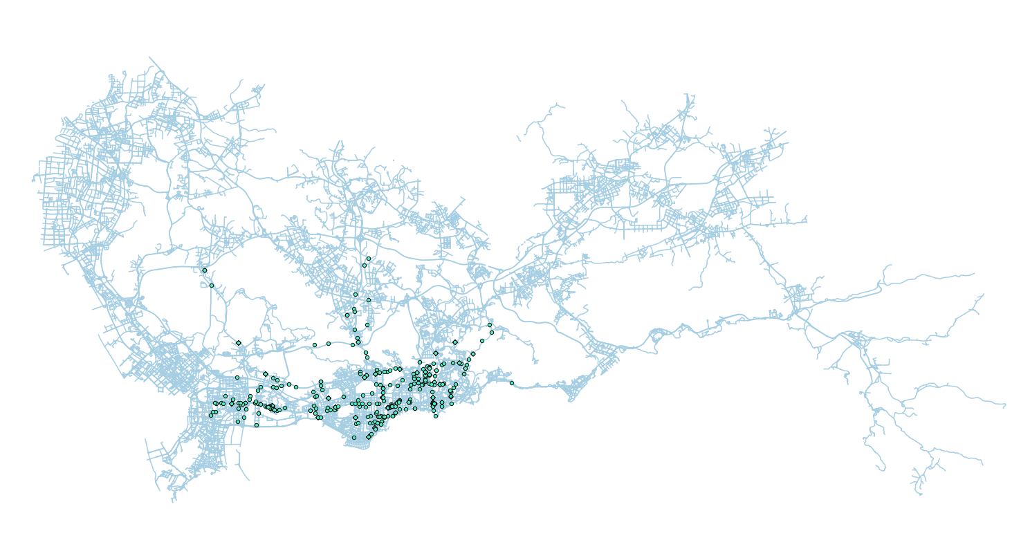
15 – 16 PM

Slide 21
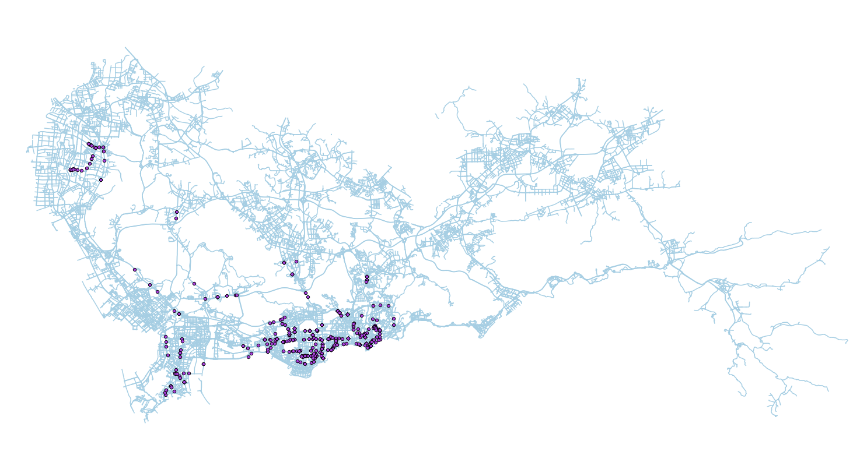
16 – 17 PM

Slide 22
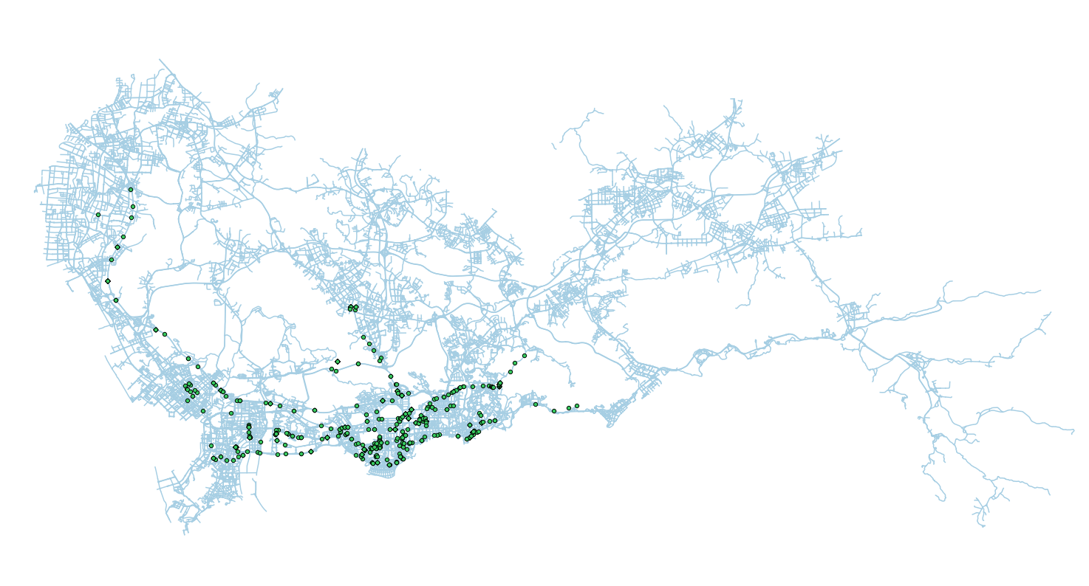
17 – 18 PM

Slide 23
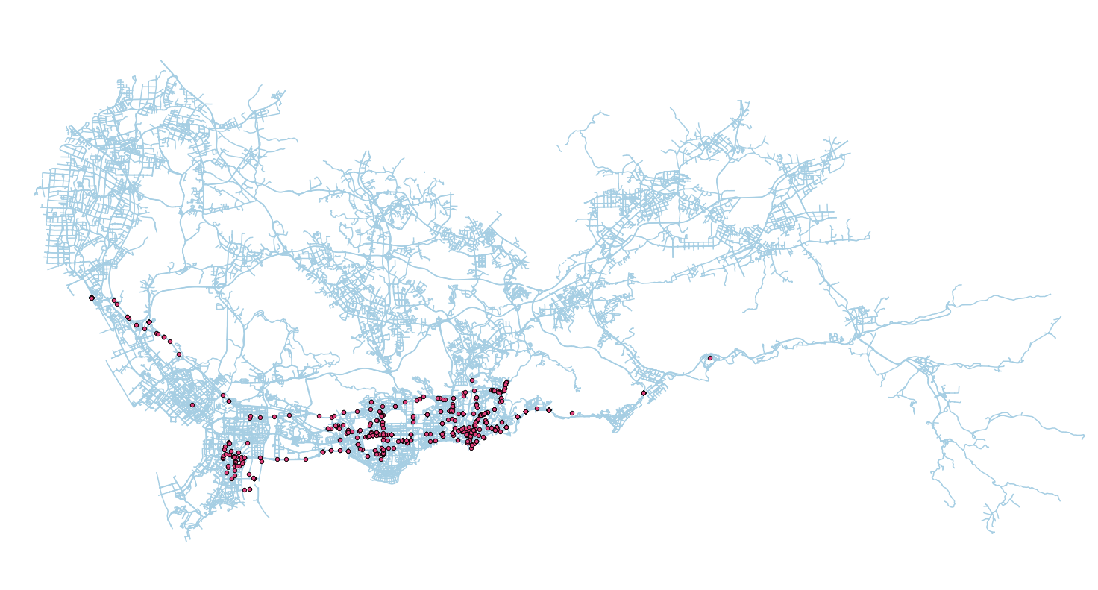
18 – 19 PM

Slide 24

19 – 20 PM

Slide 25
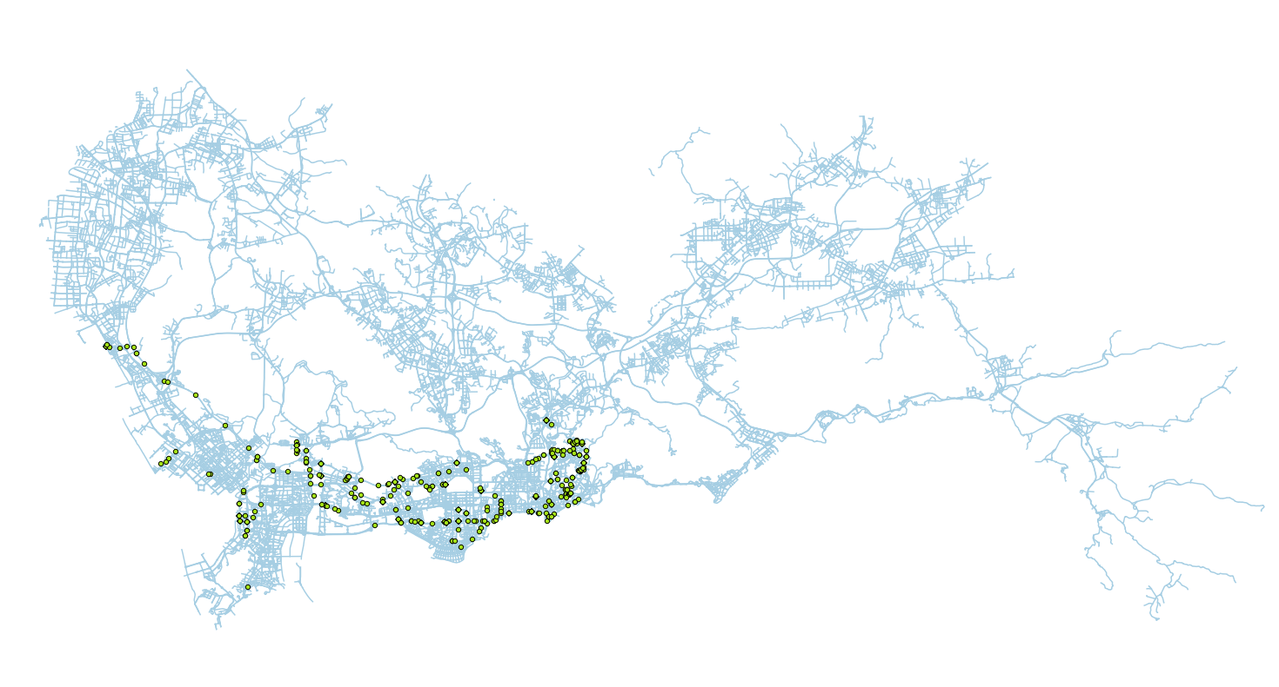
20 – 21 PM

Slide 26
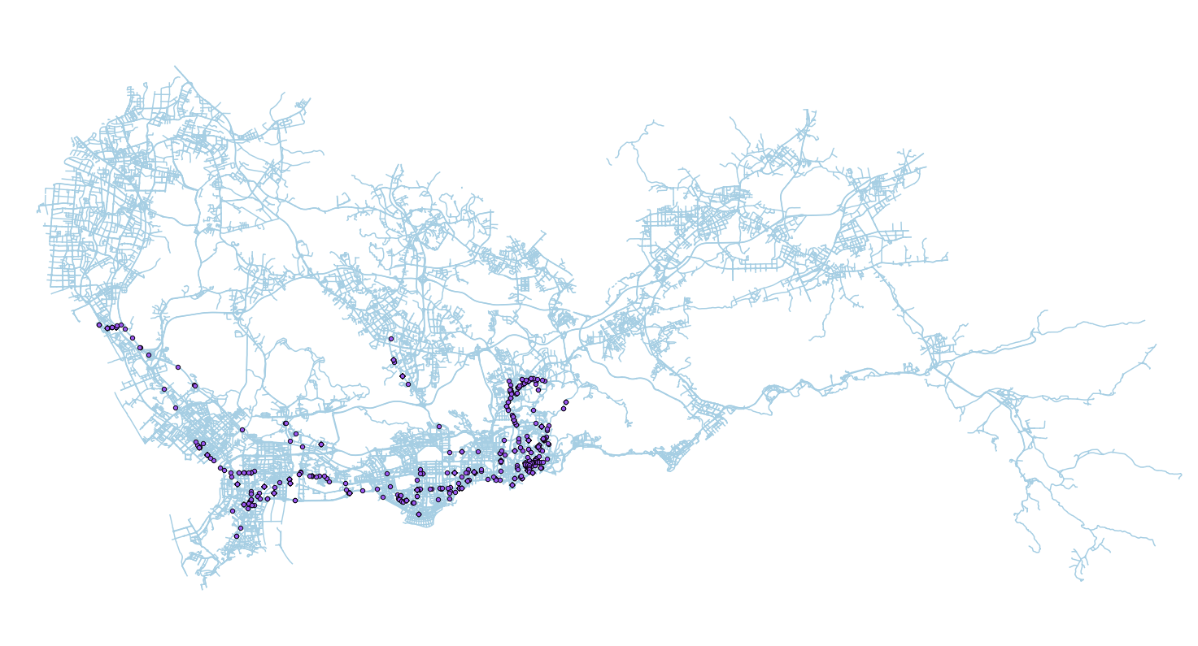
21 – 22 PM

Slide 27

22 – 23 PM

Slide 28
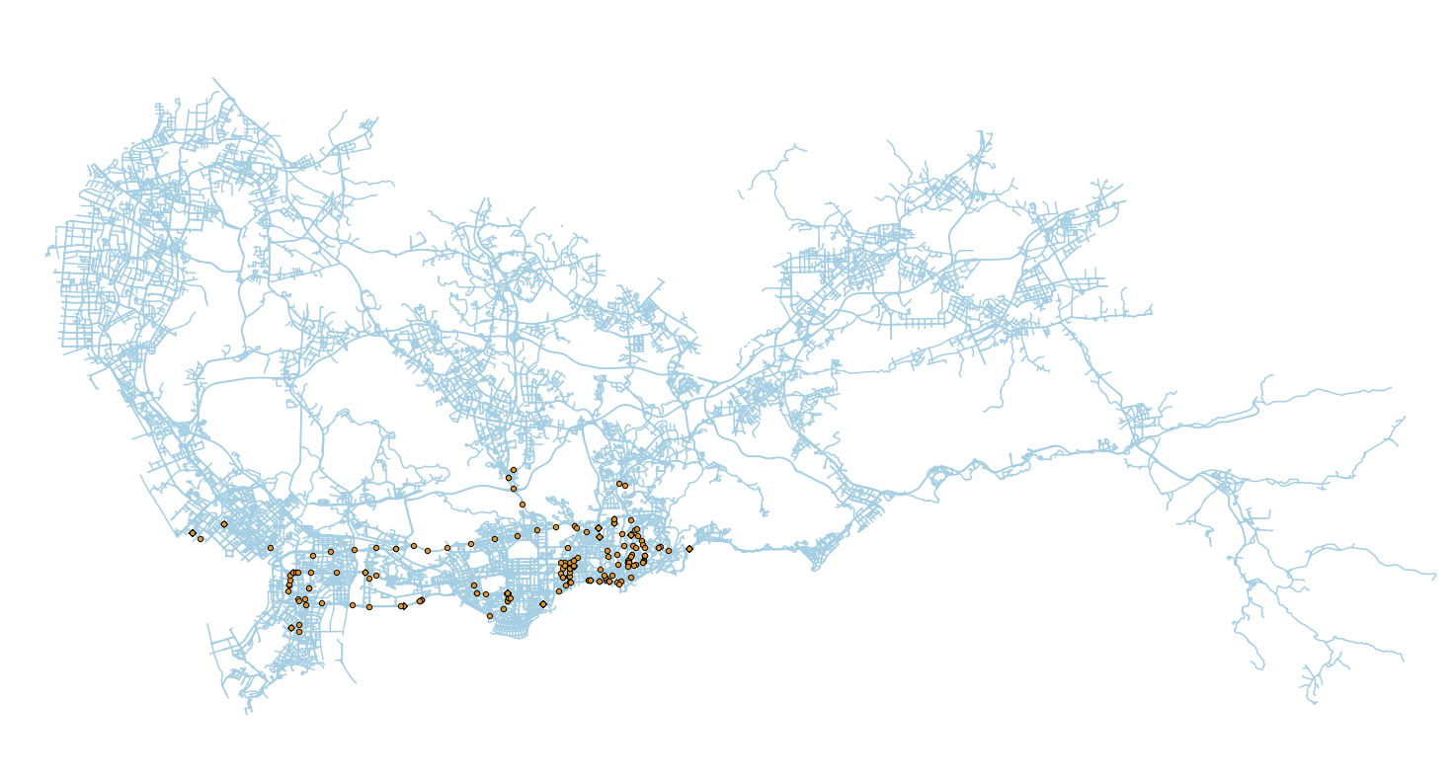
23 – 0 AM

Slide 29
09/08/2009
0 – 1 AM

Slide 30
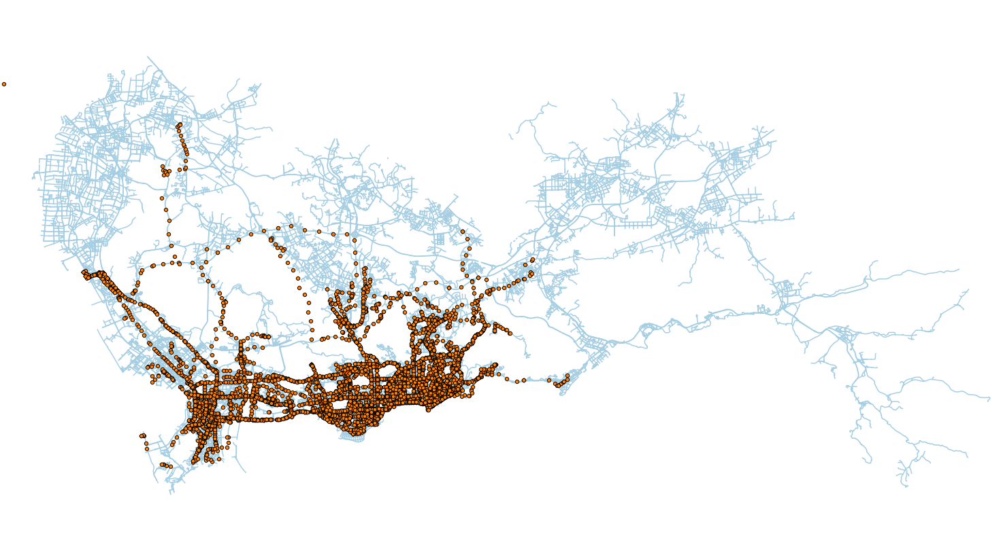
09/11/2009
0 – 1 AM

Slide 31
09/08/2009
1 – 2 AM

Slide 32
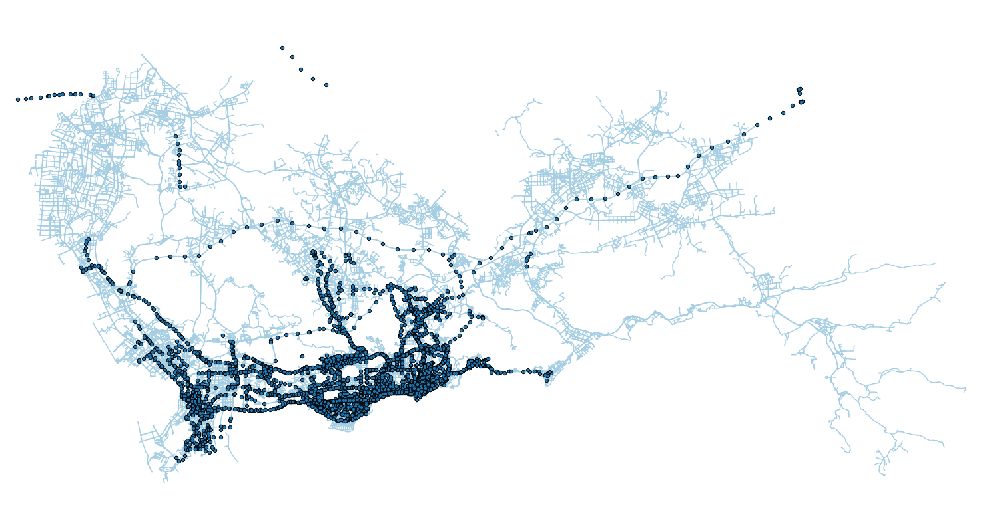
09/11/2009
1 – 2 AM

Slide 33
09/08/2009
2 – 3 AM

Slide 34
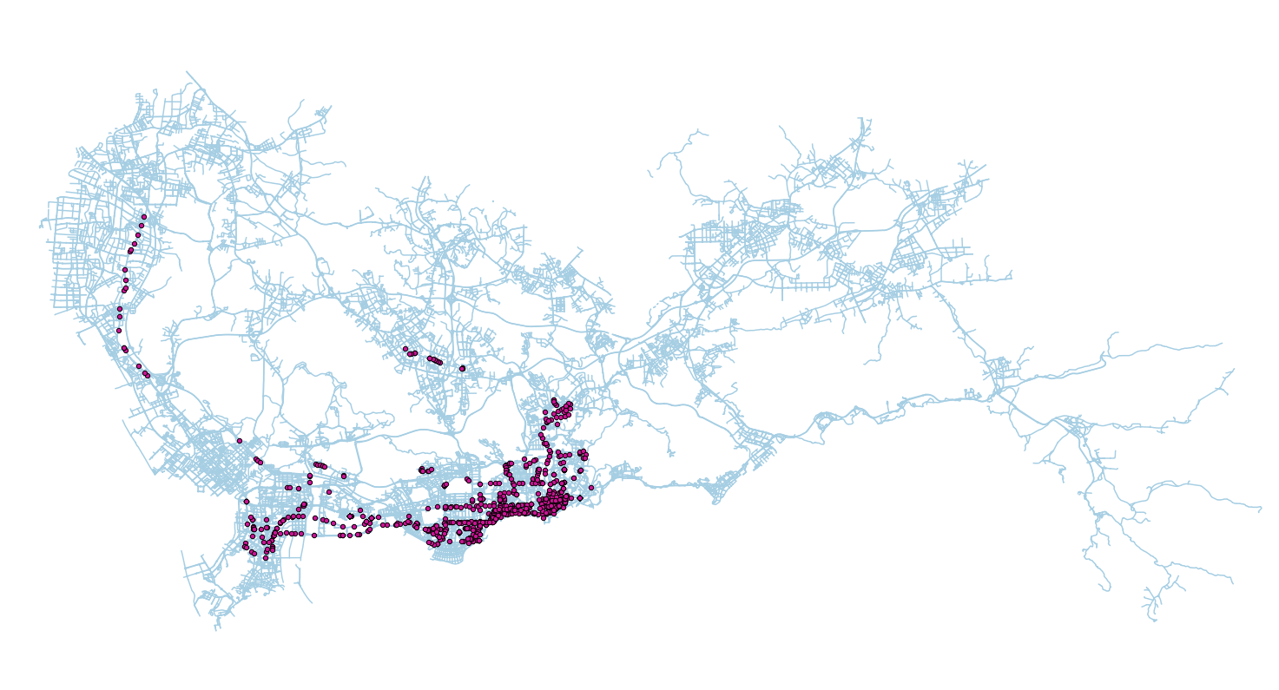
09/11/2009
2 – 3 AM

Slide 35
09/08/2009
3 – 4 AM

Slide 36

09/08/2009
3 – 4 AM

Slide 37
Analysis
Questions
Where are the golden areas?
How the golden area varies hour by hour?
Business Value
Understand demand by area
Understand demand by area by time

Slide 39
Golden Area
Map segmentation

Slide 40
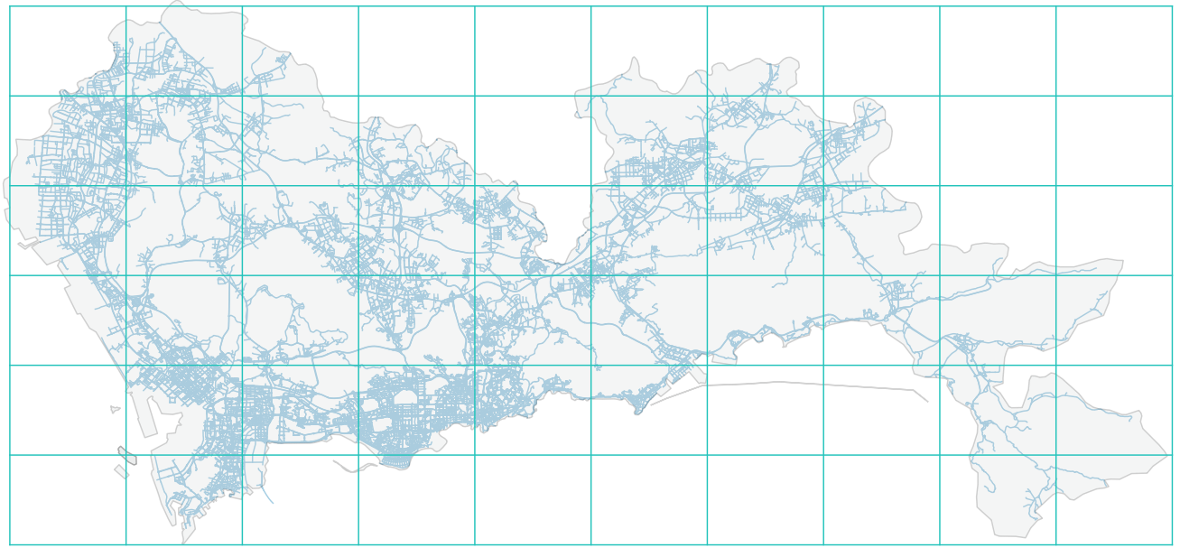
1 2 3 4 5 6 7 8 9 10
11 12 13 14 15 16 17 18 19 20
21 22 23 24 25 26 27 28 29 30
31 32 33 34 35 36 37 38 39 40
41 42 43 44 45 46 47 48 49 50
51 52 53 54 55 56 57 58 59 60

Slide 41
Golden Area
Map segmentation
Find out “Trip” from GPS data

Slide 42
Golden Area – Trip (approximation)
GSP data has a relatively fixed interval
40 s
50 s
80 s
Set threshold of 300 s to separate trips
First point as start, last point as end

Slide 43
Golden Area – Trip (approximation)
Trip# | Start Longitude | Start Latitude | Destination Longitude | Destination Latitude
1 | 114.0492 | 22.52568 | 114.0371 | 22.52340
2 | 113.8307 | 22.65009 | 113.9186 | 22.52726
3 | 114.0991 | 22.57256 | 114.1011 | 22.60015

Slide 44
Golden Area
Map segmentation
Find out “Trip” from GPS data
Social graph - Adjacent matrix

Slide 45
Golden Area – Directed Graph
2
3
1
6
5
4

Slide 46
Golden Area – Directed Graph
 |  | End
 |  | 1 | 2 | 3 | 4 | 5 | 6
Start | 1 | 0 | 10 | 0 | 0 | 6 | 0
 | 2 | 0 | 0 | 0 | 0 | 0 | 0
 | 3 | 0 | 0 | 0 | 4 | 0 | 0
 | 4 | 0 | 0 | 0 | 20 | 0 | 0
 | 5 | 7 | 0 | 8 | 2 | 0 | 0
 | 6 | 0 | 0 | 0 | 0 | 0 | 0

Slide 47
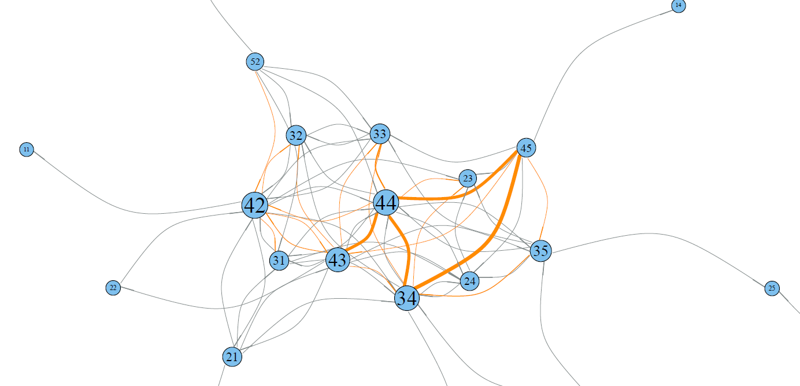
Taxi Trip Graph
Golden Area:
44
42
43
34
45

Slide 48
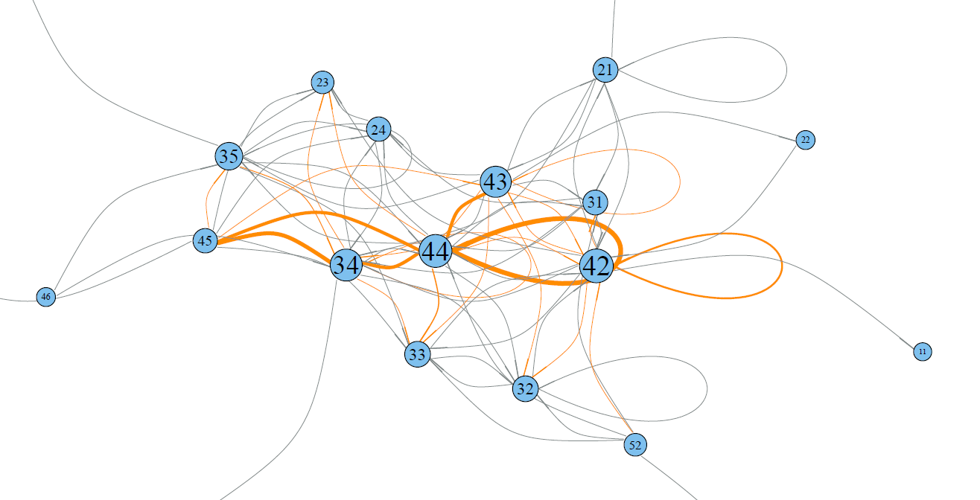
Taxi Trip Graph
Golden Area:
44
42
34
43
35

Slide 49
Taxi Trip Graph
Two Type of Golden Area
Inter-node connection
Loop

Slide 50
1 2 3 4 5 6 7 8 9 10
11 12 13 14 15 16 17 18 19 20
21 22 23 24 25 26 27 28 29 30
31 32 33 34 35 3636 37 3387 38 39 40
34 35
41 42 43 44 45 46 47 48 49 50
42 43 44 45
51 52 53 54 55 56 57 58 59 60

Slide 51
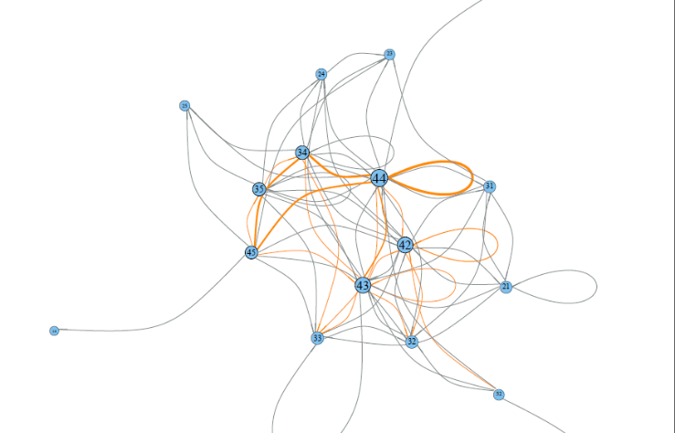
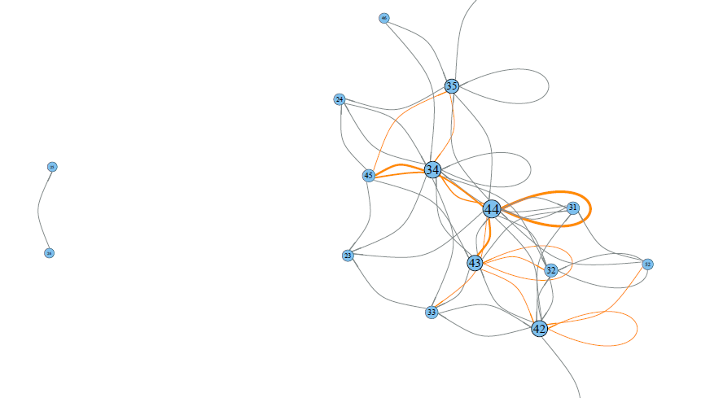
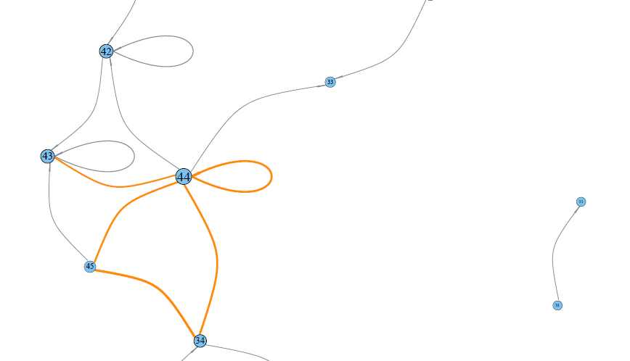
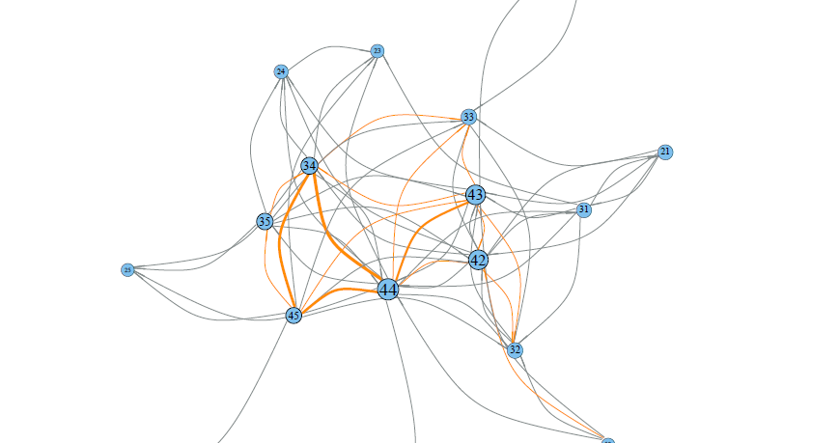
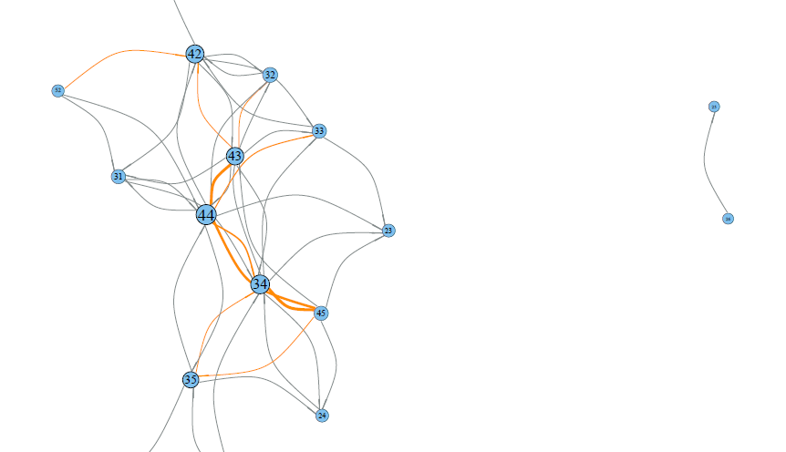
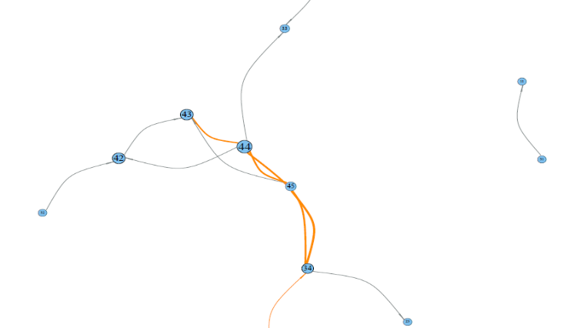
Taxi Trip Graph – By Hour
0 – 1 AM
1 – 2 AM
2 – 3 AM

Slide 52
Taxi Trip Graph – By Hour
Time Slot | Only Inter-Area | With Loop
0 – 1 AM | 44, 43, 42, 45 | 44, 43, 42, 45
1 – 2 AM | 44, 34, 42, 43 | 44, 34, 43, 42
2 – 3 AM | 44, 43, 42, 34 | 44, 42, 43, 34
Is It Trash?
Limited Data
Area of Focus
Subgroup

Slide 53
MIB
Final Presentation (Cont.)
Qifan Shi

Slide 54
Golden Area
Definition:
The area that is heavily involved in taxi trips, it should be either as a start or an end of a trip, or both.

Slide 55
Golden Area
2
3
1
6
5
4

Slide 56
Golden Area
2
3
1
6
5
4

Slide 57
Golden Area
103
2
33
3
21
1
7
6
18
11
5
4
94

Slide 58
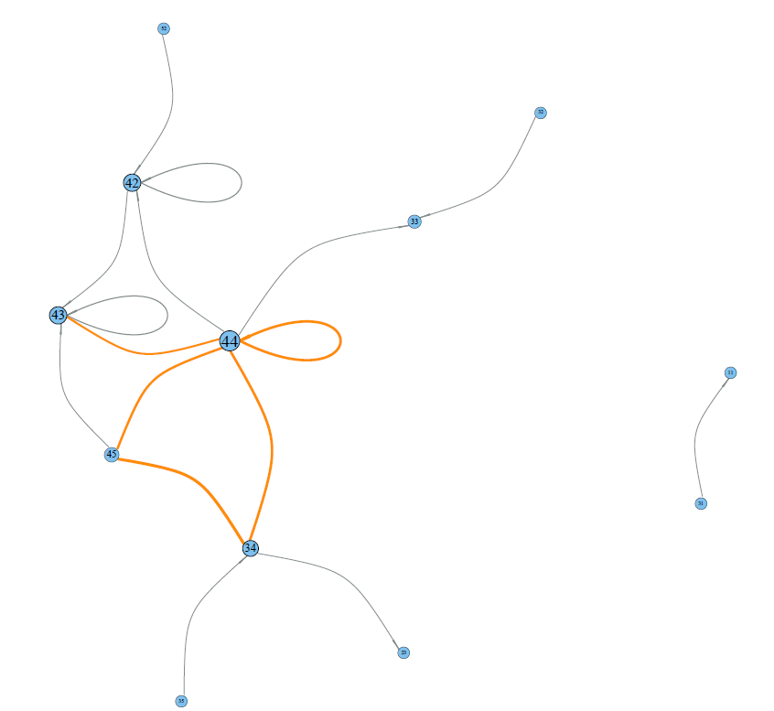
Golden Area – 09/11/2009, 2-3 AM

Slide 59

Golden Area – Decision Making
34
35
Q1:
35 -> 34 ?
42
43
44
45

Slide 60
Golden Area – Decision Making
34
35
Q2:
34 -> 35 ?
42
43
44
45

Slide 61
Golden Area – Decision Making
34
35
Q3:
42 -> 45 ?
42
43
44
45

Slide 62
Routing Recommendation System
More complex modeling is needed
More quantitative information is needed (Probability)

Slide 63

Taxi Fare

Slide 64
What’s Next
Link income with trip
Focus on dense area
Remove (43, 42, 44) and focus on the rest
Layering
Level 1 – 44, 43, 42, 34
Level 2 – 52, 31, 32
Level 3 – 12, 21

Slide 65
What I learned
Quality of data
How to approach
Big data?
Notes:
raw, No direct connection between taxi fare and trajectory, difficult, out of control
Clean, in control, get trip by manipulating gps data. Filtering data with when car is ccupied by passengers, income and gps data not perfectly match , find intersetion

Slide 66

Q & A

Slide 67
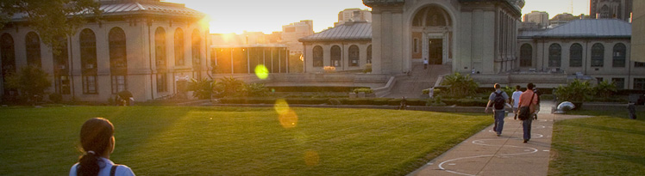
“All models are wrong,
but some are useful”

